Slide 1



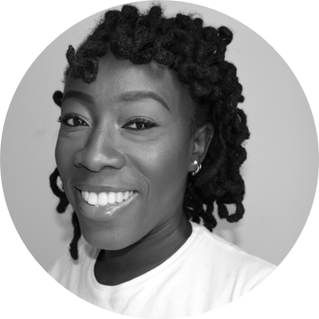

Benjamina Efua Dadzie – Analyst
Professional experience
Education and skills
Africa Foresight Group
Conducted the Ghana DD and report writing for Alquity and Philanthropy University Transforming Lives Awards worth $100,000 in 2019
Led the report writing for a GIZ market research into job creation sectors in Ghana
Supported the research into innovative tech ecosystems in Africa for Harambe Entrepreneur Alliance
Supported AFG Talent Administration and Recruitment in Q1 2019
Future of Ghana, London and Accra
Managed the delivery of the EU-funded 'Future of Enterprise in Ghana-MADE West Africa Pilot Project,’ a job creation training programme which exceeded key targets
Managed the operations and report writing for a one-week UK National Lottery Community Fund mentorship programme in London for vulnerable young people
Led social media strategy and digital communication for the 2017 Ghana Diaspora Homecoming Summit, organised and hosted by the Government of Ghana
SAGE Publishing, London
Supported the Editorial Books department in the project management and delivery of multi-volume reference books for academics and early career researchers
Restructured the reward scheme and championed the voice of diverse scholars for book reviews and endorsements.
Benjamina holds a BA with Honours in Archaeology from the University of Manchester and an MA in Anthropology from the University of East Anglia
She is a former Graduate Attaché at the British Institute in Eastern Africa, Nairobi, Kenya, where she facilitated anthropological research
Benjamina speaks English, Italian, Twi, and Fanti fluently, and understands basic Nzema.
Introduction
I have a varied experience in the cultural and heritage sector, youth work, communication, publishing, academic research, and talent administration. I have developed and maintained a network of colleagues and acquaintances across three countries over two continents, which provide me strong interpersonal skills and the ability to adapt and support diverse audiences and stakeholders.
I joined Africa Foresight Group in January 2019, to support the firm with my multidisciplinary skills and wide interest in people and project management. I have been pleased to use my research skills as part of the core team and as a consultant.

